Slide 1
Spring Field Hospital
An Advance Database Project…

Slide 2
Team Members
Parth Chandgadhiya 300986134
Reneton Jayakumar 300939376
Agapito Feliciano 301033578
Kien Luong Ly 300925214

Slide 3
Introduction
Developed for medical professions.
database will have patients’ profile ready at hand for medical professions and medical directors to view their patient general information to what ward, disease, treatment, and the recovery room where patient is located.
Database will allow all hospital staff to know the patient current health and determine the best course of action when they can see their patient profile that they can pull from the database.

Slide 4
Business Information
system read, write, and store data from what doctors and medical personal put into the database.
The system should be relevant, reliable, accurate, bug-free, and provide an outstanding user experience.
All medical personal can update any patient profile whenever they need too. System will constantly back up itself, so data will be lost or corrupted.

Slide 5
Business Roles
Appointment number
The appointment number is generated by the system. It’s 6 digits and it’s always unique with each appointment. Appointments can only be created if a person has a valid Ontario health card.
Administration
Administrators are people who verify that patients have a valid name, address, telephone, OHIP, and a SIN. Security on this level is a lot tighter and strict.
Patient
Someone receiving treatment from a doctor. A Patient needs a name, address, telephone, OHIP, SIN, and optional have benefits or health insurance

Slide 6

Problem Definition
Managing a hospital patient and retrieving their info can be quite difficult especially in an environment were every second count.
It’s time consuming if everything must be reviewed by looking through profiles rather than having a “straight to the point” system on a patient health.
Rather than just storing and showing data, Spring Field system will help optimize utilization of hospital employees, occupancy rates, clinical decisions and all the other aspects related to hospitals.
It’s cost effective.

Slide 7
Fact Finding
New patients can be registered by the hospital registration system or having an auto fill registry if the patient comes in through an emergency vehicle.
Doctors and patient should be able to create appointments through a doctor or visiting the hospital.
Medical personal should be able to update their patient information. Patient can also request to have their information changed after proper verification.
OHIP and SIN number always valid and stored in the database. The Ontario Healthcare can not run without these two vital features.
The database is required to make backup of the current database at certain times. The back up data must be able to recover and restore easily.

Slide 8
Business Rules
A patient must have valid identification, health card (OHIP), and a SIN number.
Appointment can only generate if a patient has meet valid requirements to get one
All appointments must have a start date and an end date, and they end date can’t be past the start date
All tables must be filled in any patient, doctor, hospital, room, and admin. The only exception is insurance since it’s optional
All Tables except for appointment table and duty doctor table must have a unique ID

Slide 9
Database Users
User
They have access to their patient profile
They can make update to their patient profile whenever they need
Manager
Accessible to any information at any given time
Manages all patient information
Admin
Control over entire system
Manages the entire database
Access and change information with no restriction

Slide 10

Tabels
There are 14 Tables that we used:
AdminAppointment
Appointment
Administration
Hospital
Doctor
DutyDoctor
Duty
Files
Diseases
Result
Admission
Room
Patient
Sanitary

Slide 11

ERD

Slide 12
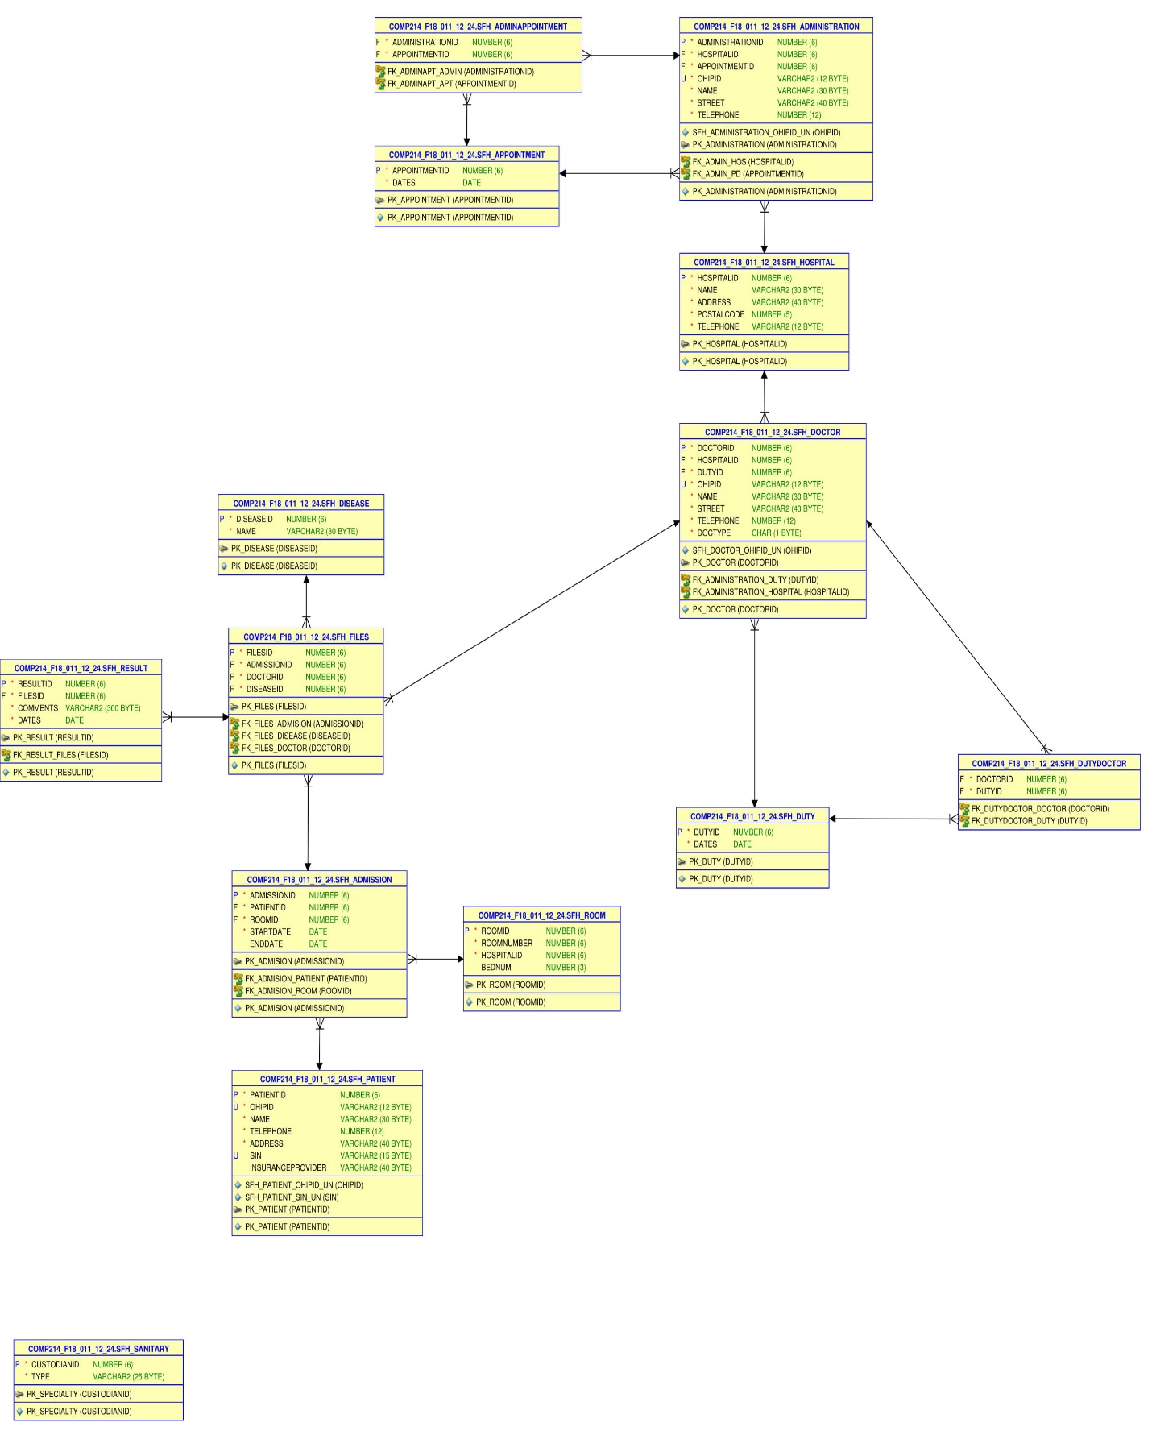

Slide 13
Queries

Slide 14
Procedures
Procedure to get the history of patient
CREATE OR REPLACE
PROCEDURE historyOfPatient(p_ohipID VARCHAR)
AS
v_filesID SFH_files. filesID%TYPE;
v_ohipID SFH_Patient.ohipID%TYPE;
v_name SFH_Patient.name%TYPE;
v_roomID SFH_admission.roomID%TYPE;
v_startDate SFH_admission.startDate%TYPE;
v_endDate SFH_admission.endDate%TYPE;
v_doctorID SFH_files.doctorID%TYPE;
v_docname SFH_doctor.name%TYPE;
v_diname SFH_Disease.name%TYPE;
v_comments SFH_result.comments%TYPE;
v_dates SFH_result.dates%TYPE;
cursor history is select * from patienthistory h where h.ohipID = p_ohipID order by "Admission Date";
begin
open history;
loop
fetch history into v_filesID, v_ohipID, v_name, v_roomID,v_startDate, v_endDate, v_doctorID, v_docname, v_diname,v_comments, v_dates;
exit when history%notfound;
dbms_output.put_line('filesID | ohipID | name | Roomid | Admission Date | doctorID | Doctor Name | Disease | comments | Result Date');
dbms_output.put_line(v_filesID ||' ' || v_ohipID ||' '|| v_name ||' '|| v_roomID ||' '|| v_startDate||' ' || v_doctorID ||' ' || v_docname ||' '|| v_diname ||' '|| v_comments ||' '|| v_dates);
end loop;
close history;
end historyOfPatient;

Slide 15

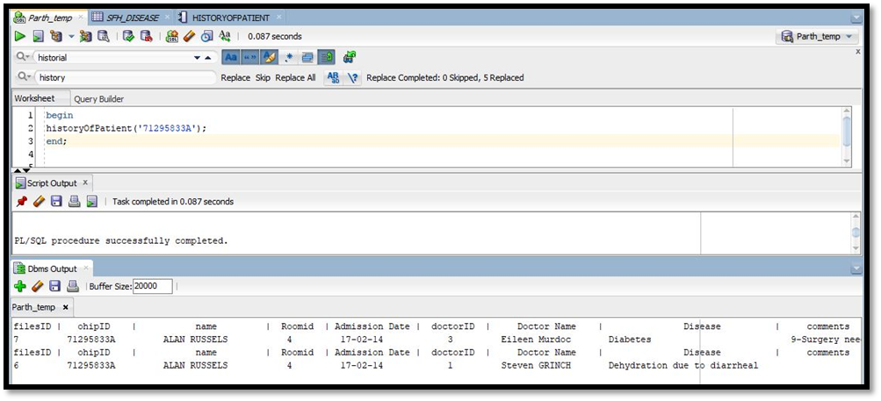
Procedures Continued
FUNCTION query
begin
historyOfPatient('71295833A');
end;

Slide 16
Procedures Continued
Procedure that shows analysis of diseases id entered
CREATE OR REPLACE
PROCEDURE diseaseAnalysis(p_diseaseID NUMBER)
AS
v_cont NUMBER(2);
v_filesID SFH_files.filesID%TYPE;
v_comments VARCHAR2(300);
v_dates DATE;
cursor filesID is select filesID from SFH_files f where f.diseaseID = p_diseaseID;
cursor SFH_result (p_filesID in number) is
select comments, dates from SFH_result where filesID = p_filesID;
begin
open filesID;
loop
fetch filesID into v_filesID;
exit when filesID%notfound;
open SFH_result(v_filesID);
loop
fetch SFH_result into v_comments, v_dates;
exit when SFH_result%notfound;
dbms_output.put_line('diseaseID:'||p_diseaseID||' filesID:'||v_filesID||' comments:'||v_comments||' dates:'||v_dates);
end loop;
close SFH_result;
end loop;
close filesID;
end diseaseAnalysis;

Slide 17
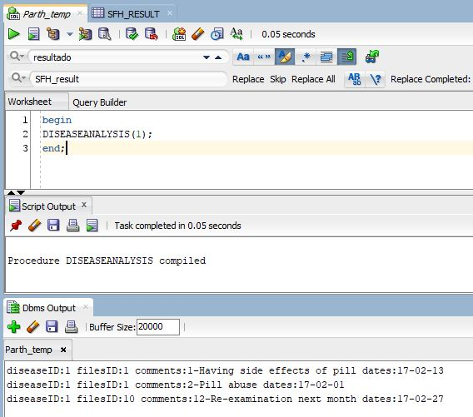
Procedures Continued
FUNCTION query
begin
DISEASEANALYSIS(1);
end;

Slide 18
In Depth View
Disease | Appointment | Patient | RoomID | RoomNumber | BedNum
1 | 1 | 1 | 1 | 25 | 4
 | 7 | 5 | 8 | 24 | 3

Slide 19
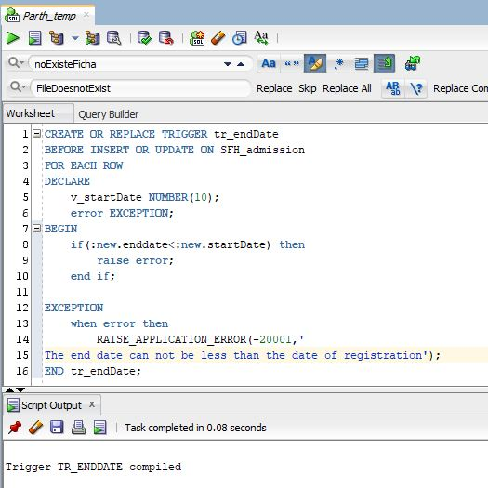
Triggers
Start date must be earlier than end date
CREATE OR REPLACE TRIGGER tr_endDate
BEFORE INSERT OR UPDATE ON SFH_admission
FOR EACH ROW
DECLARE
v_startDate NUMBER(10);
error EXCEPTION;
BEGIN
if(:new.enddate<:new.startDate) then
raise error;
end if;
EXCEPTION
when error then
RAISE_APPLICATION_ERROR(-20001,'
The end date can not be less than the date of registration');
END tr_endDate;

Slide 20
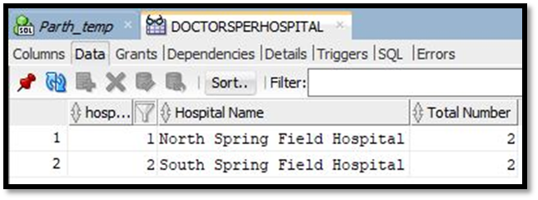
Views
Number of Doctors per Hospital
CREATE VIEW DoctorsPerHospital AS
select h.hospitalID as "hospital Id" , h.Name as "Hospital Name", count(*) as "Total Number" from SFH_Hospital h, SFH_doctor s
where s.doctorType ='M' and s.hospitalID = h.hospitalID
group by h.hospitalID , h.Name
order by h.hospitalID;

Slide 21
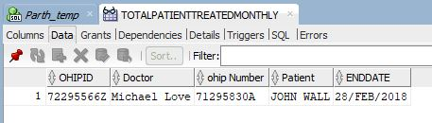
Views Continued
Total Patient Treated in one month
CREATE VIEW TotalPatientTreatedMonthly AS
SELECT SFH_doctor.ohipID, SFH_doctor.name as "Doctor", SFH_Patient.ohipID as "ohip Number", SFH_Patient.name as "Patient", sfh_admission.enddate
FROM SFH_Patient,SFH_doctor, SFH_files, SFH_admission
WHERE SFH_doctor.doctortype = 'M'
and SFH_doctor.doctorID = SFH_files.doctorID
and SFH_admission.admissionID = SFH_files.admissionID
and SFH_Patient.patientID = SFH_admission.patientID
and SFH_admission.enddate = (select max(enddate) from SFH_admission)
order by SFH_doctor.doctorID desc;

Slide 22
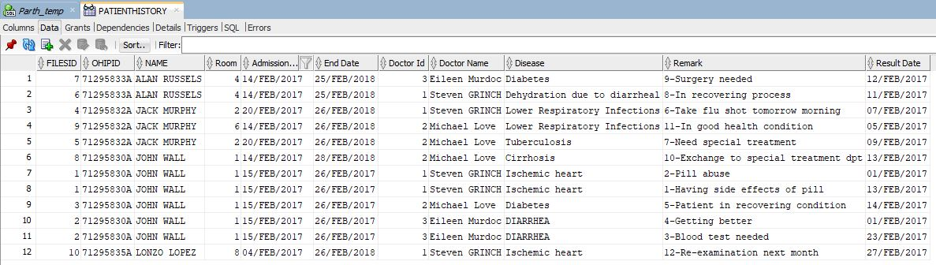
Views Continued
History for patients
CREATE VIEW PatientHistory AS
select f.filesID, p.ohipID, p.name, a.roomID as "Room", a.startDate as "Admission Date", a.endDate as "End Date", f.doctorID as "Doctor Id", d.name as "Doctor Name", di.name as "Disease", r.comments as "Remark", r.dates as "Result Date"
from SFH_Patient p, SFH_admission a, SFH_files f, SFH_result r, SFH_doctor d, SFH_Disease di
where p.patientID = a.patientID and
a.admissionID = f.admissionID and
r.filesID = f.filesID and
f.doctorID = d.doctorID and
f.diseaseID = di.diseaseID
order by p.name;

Slide 23
Any Questions?

Slide 24

Thank you

